Slide 1


• We’ll start in a moment :) • We may record tonight’s event and plan to take screenshots for social media. • If you want to remain anonymous, use your first name & keep video off. • We’ll introduce the hosts and break in-between for Q/A. • We will make some time for Q&A at the end of the presentation as well. • Online event best practices: • Mute yourself when you aren’t talking. • Turn on your video if you feel comfortable!
Welcome!

Slide 2
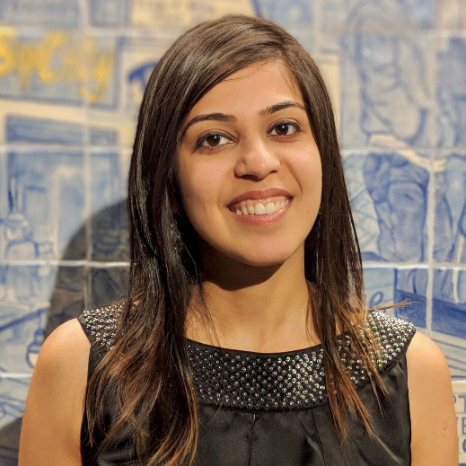
• Welcome from WWCode! • Our mission: Inspiring women to excel in technology careers. • Our vision: A world where women are representative as technical executives, founders, VCs, board members and software engineers.
Prachi Shah
Senior Software Engineer | Metromile

Slide 3

WWCode Digital + Backend
Backend Study Group
April 22, 2021

Slide 4
• Third ever Backend Study Group session!
• Topic: Software Design Patterns [Part 1 of 5] • Creational Design Patterns • Structural Design Patterns
• Behavioral Design Patterns • Anti-patterns and design principles • Interview Questions
• WWCode GitHub and Demo
• WWCode YouTube channel:
• March 25, 2021 session recording: Backend Study Group session 1
• April 8, 2021 session recording: Backend Study Group session 2
• Technical Tracks • Check our Digital Events • Get updates – join the Digital mailing list! • Survey
Resources

Slide 5
• What is Backend Engineering?
• Software Design • Object Oriented Programming (OOP) principles
• Design patterns
• Types of patterns
• Top 3 Creational patterns • Q/A • Resources:
• Software design pattern
• Design Patterns in Java • Design patterns • Design Patterns • Head First Design Patterns book
Agenda

Slide 6
• What is Backend Engineering?
• Design, build and maintain server-side web applications. • Concepts: Client-server architecture, API, micro-service, database engineering, etc.
Software Design • Defining the architecture, modules, interfaces and data • Solve a problem or build a product • Define the input, output, business rules, data schema • Design patterns solve common problems • 3 Types: • UI design: Data visualization and presentation • Data design: Data representation and storage • Process design: Validation, manipulation and storage of data • Distributed systems, storage, performance, deployment, availability, monitoring
Backend Engineering

Slide 7
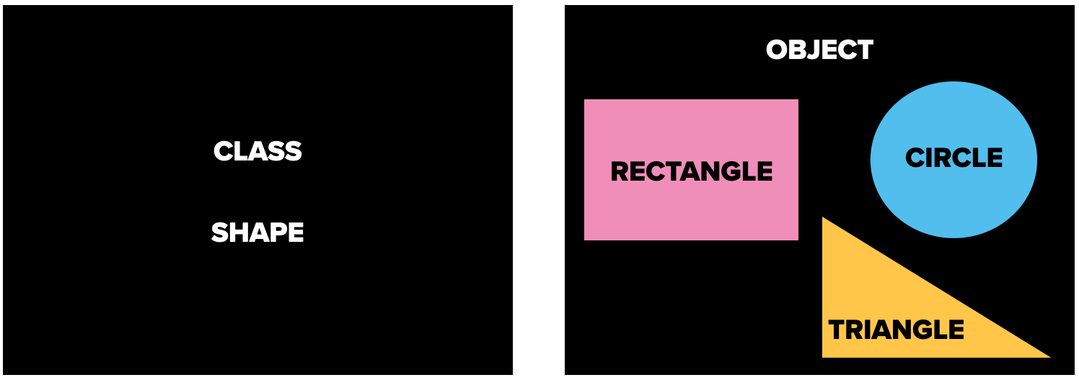
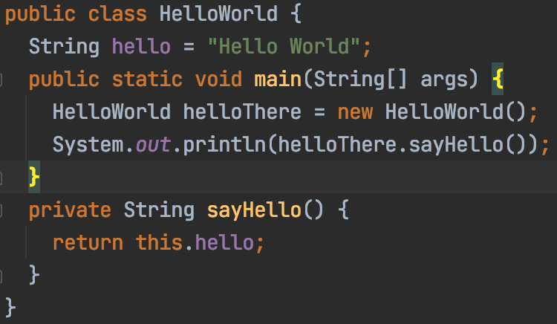
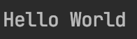
Backend Engineering
Object Oriented Programming (OOP) • Create objects with data (attributes) and functions (methods) • Structured and minimal code • Don’t Repeat Yourself [DRY] to easily change, maintain and debug • Class: Template: data and functions • Object: • Instance of a class • Many objects per class

Slide 8
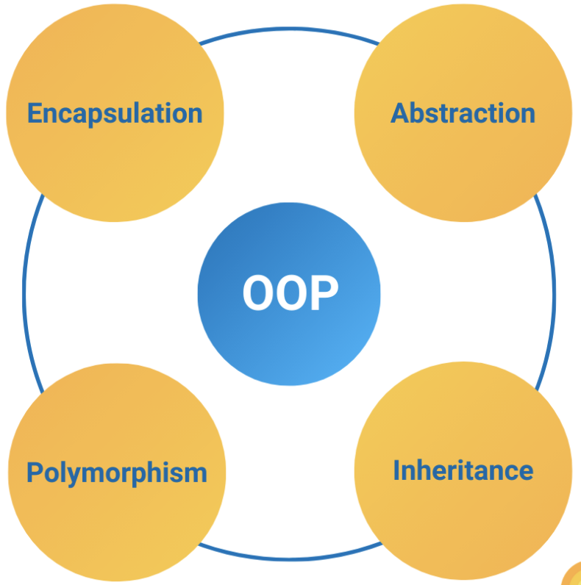
Backend Engineering
• Constructor: • Initialize objects: initialize attributes • Called when objects are created • Name matches class name, has no return type, default and custom constructors • Access Modifiers: • private: visible inside the same class • public: visible everywhere • protected: same class, subclasses, packages • Principles: • Abstraction • Encapsulation • Polymorphism • Inheritance

Slide 9
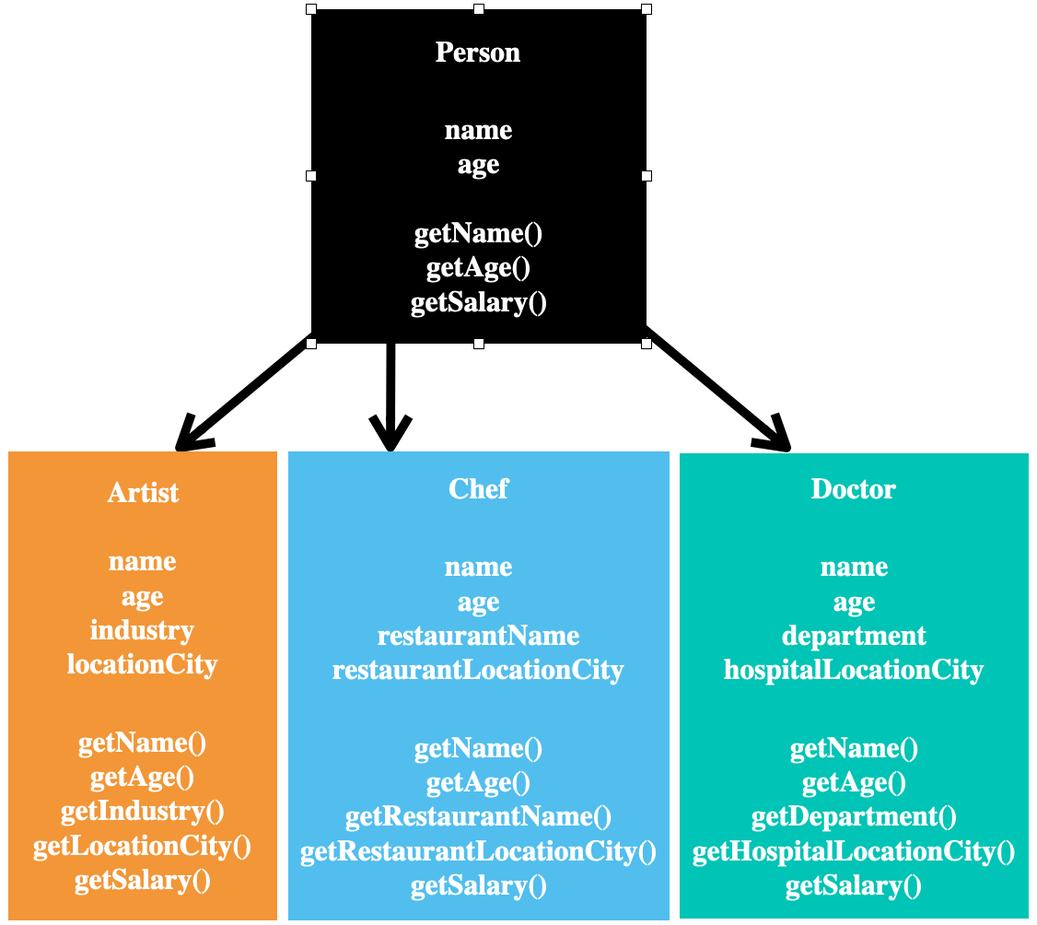
Backend Engineering
• Abstraction: • Hide complexity and details • Caller does not need to know the details • Each class has its own abstraction • Easy to maintain code and add features • Example: Instant Pot • Types: • Data abstraction: • Getter and setter methods • Example: getName(), getAge() • Process abstraction: • Function implementation varies • getSalary() • Code example

Slide 10
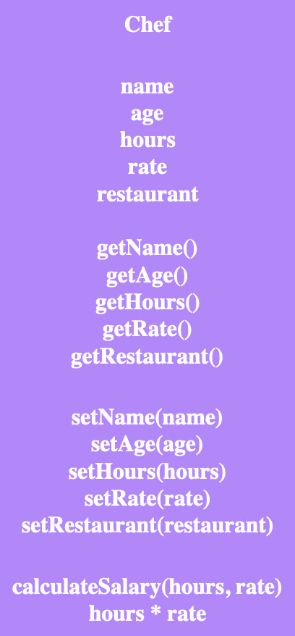
Backend Engineering
• Encapsulation: • Bundle data and methods into one unit (class) • Entity: data and operations match real-world scenario • Hide data from users • Declare attributes as private • get() and set() methods to access data • Better control over data access and methods • Improved security of data • Data can be read-only or write-only • Code example

Slide 11
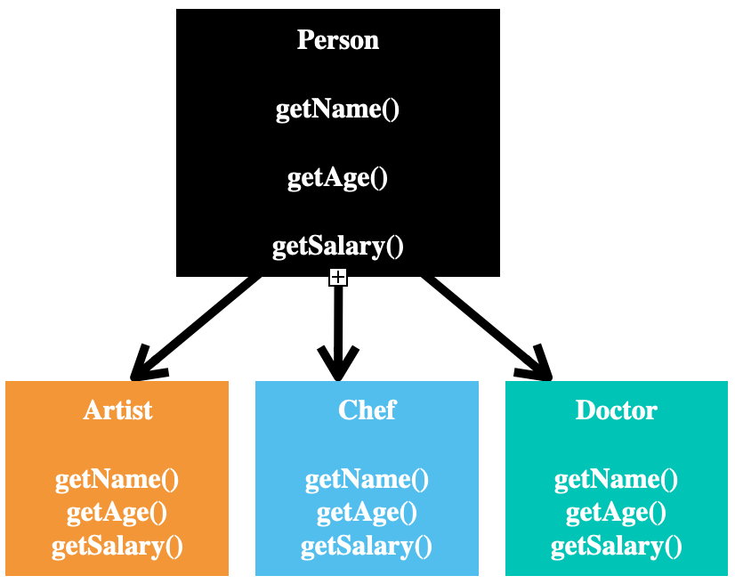
Backend Engineering
• Inheritance: • Derive a class from another class • Classes share attributes & methods • Hierarchy of super class, sub class • extends keyword • Reusability • Code example

Slide 12
Backend Engineering
• Polymorphism: • Use same interface for different classes • is-a relationship • implements keyword • Interface has public methods without implementation • Implementing class overrides all of these methods • Implementing class provides own function/ logic • Code example

Slide 13
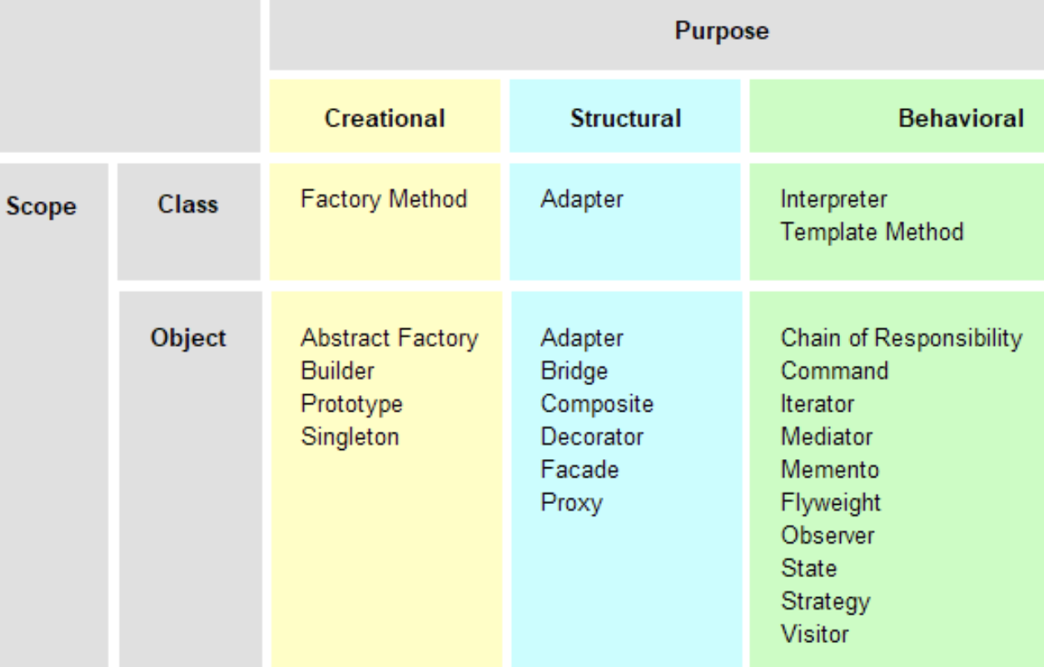
Backend Engineering
Design Patterns • Set of template solutions that can be reused • Shared pattern vocabulary • Improved code maintainability, reusability and scaling • Not a library or framework, but recommendations for code structuring and problem solving • Adapt a pattern and improve upon it to fit application needs • Leverages OOP for flexible and maintainable designs • Defines relationship between objects, loosely coupled objects, secure objects

Slide 14
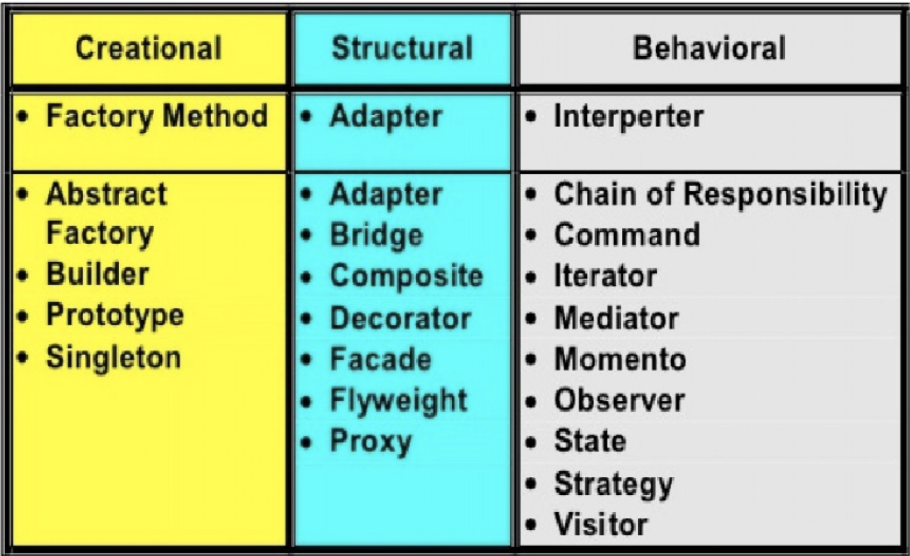
Backend Engineering
Types of Design Patterns • Creational: • Initialize a class and instantiate the objects • Decoupled from implementing system • Singleton, Factory, Builder • Abstract Factory, Prototype • Structural: • Class structure and composition • Increase code reusability and functionality • Create large objects relationships • Adapter, Facade, Decorator, etc. • Behavioural: • Relationship and communication between different classes • Observer, Strategy, Iterator, etc.

Slide 15
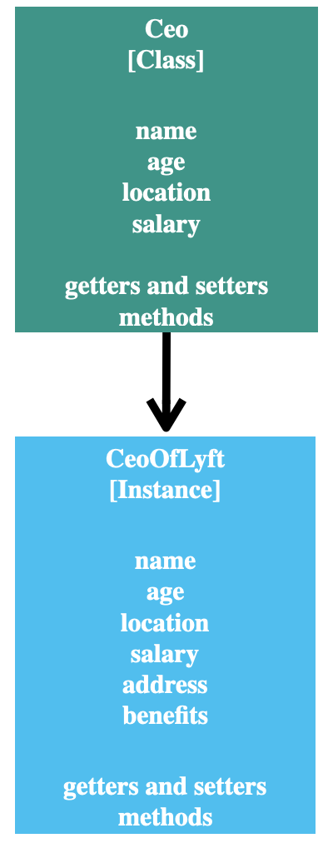
Backend Engineering
Creational Design Patterns: • Singleton: • One instance only • Instance variable is static • private constructor • Caller gets the instance from a getInstance() • Lazy initialization: Instance is created and initialized on-demand • Eager initialization: Instance is created and initialized on class load • One instance per singleton per Java Virtual Machine (JVM)
• Example: Company has one CEO; University has one Proctor • Example: Log4j logging program • Code: Ceo ceoOfLyft = Ceo.INSTANCE; • Code example

Slide 16
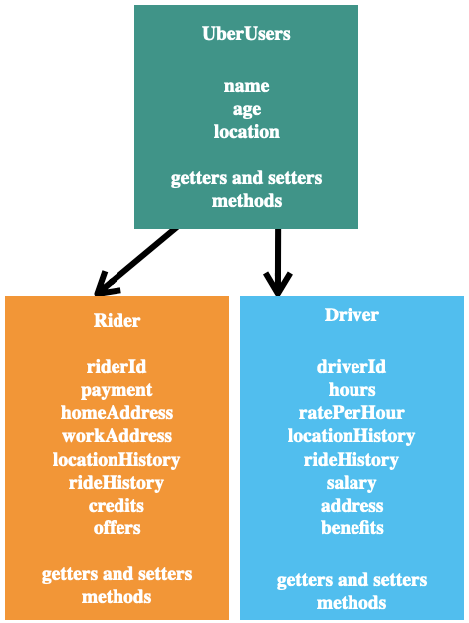
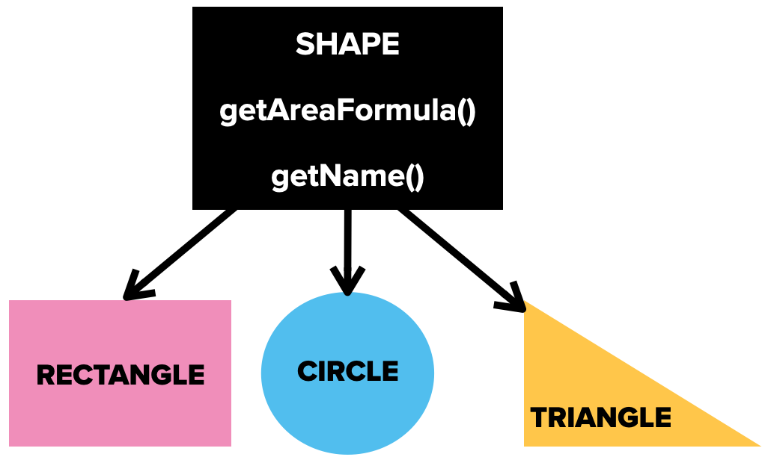
Backend Engineering
Factory: • Create an object by hiding the creation logic • Use a common interface to create objects • Create a new instance on-demand and initializes fields • Reduces code duplication, provides consistent behavior • Easy to maintain classes as creation is centralized • Loosely coupled classes • Example: Uber users • Code example

Slide 17
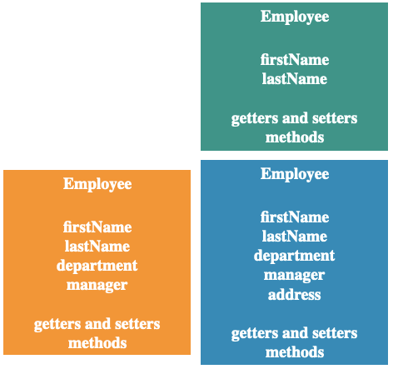
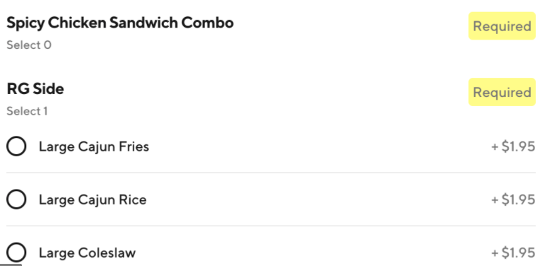
Backend Engineering
Builder: • Build custom objects of a class • Objects can be different • Use the same creation logic • Seperate the construction and representation • Flexible design, readable code, complete objects • Example: Ordering food from DoorDash • Code example

Slide 18


Backend Study Group

